Slide 1


Build Your Own Model (BYOM) Practical
Andrew J K Conlan
University of Cambridge
ajkc2@cam.ac.uk
CEMA, University of Nairobi, September 9th -14th 2024

Slide 2
Modelling Case Studies
Outbreak of influenza in a boarding school
Seasonality and periodicity of measles epidemics

Slide 3
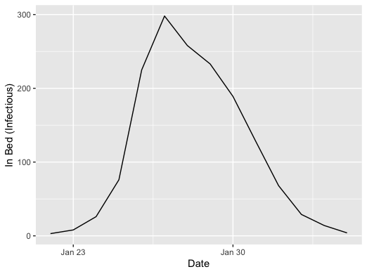

1. Outbreak of influenza in a boarding school
influenza_england_1978_school from R package "outbreaks"

Slide 4
Challenge
Implement a model to simulate the boarding school epidemic we used as a motivation for the stochastic practical in Session 3
Digitised data from the original paper is available as part of the "outbreaks" package in R
Assume:
Exposed period of ~ 1 hour
Infectious period of 2 days
Number of infectious boys approximated by numbers "in bed"
What effect on the outbreak would there have been if 80% of the boys were vaccinated with a vaccine with 50% efficacy (direct protection from infection)?
You should think carefully about how to "estimate" the parameters for your model by (qualitative) comparisons to the data
Extension
Would non-exponential infectious and latent period distributions affect your parameter estimates and/or conclusions?

Slide 5
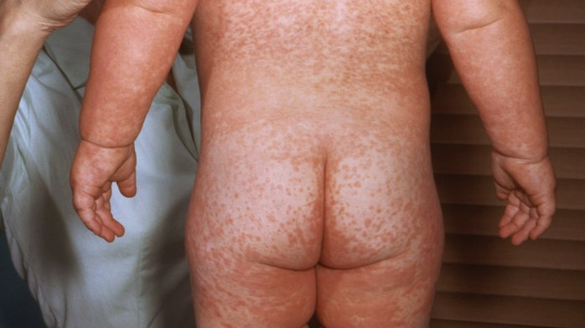
2. Seasonality and periodicity of measles epidemics
Morbillivirus – characteristic red rash (high reporting rates)
Symptoms include: fever, cough, coryza and conjunctivitis
Long term immunomodulation which likely increases contribution to childhood infectious disease mortality
Spread by aerosol transmission, no animal reservoirs
Infection results in life long immunity to reinfection
Exceptionally high reproduction ratio R₀ of ~ 17
Acute infectious period (around the same time as symptoms peak) that is short relative to the incubation (or latent) period where individuals are infected but not yet infectious

Slide 6
Measles serial interval
The serial interval of measles has been estimated directly by measuring the interval between cases in households with two siblings
The serial interval has a mean of ~ 11 days and standard deviation of ~ 2.6 days
Well represented by a gamma (Erlang) distribution ~ gamma(11,11/11)
Could be modelled as a single infectious period.
SEIR models often assume latent and infectious periods of 8 and 5 days respectively
T_{E} ~ gamma(8,8/8)
T_{I} ~ gamma(5,5/5)
Bailey 1956 https://doi.org/10.2307/2333574

Slide 7
Measles in London 1944-1964
Measles epidemics demonstrate endemic-epidemic patterns of incidence
E.g. In London there was a stable two year cycle in incidence between 1950 and 1964
The Registrar Generals Weekly Returns for England and Wales (OPCS)

Slide 8
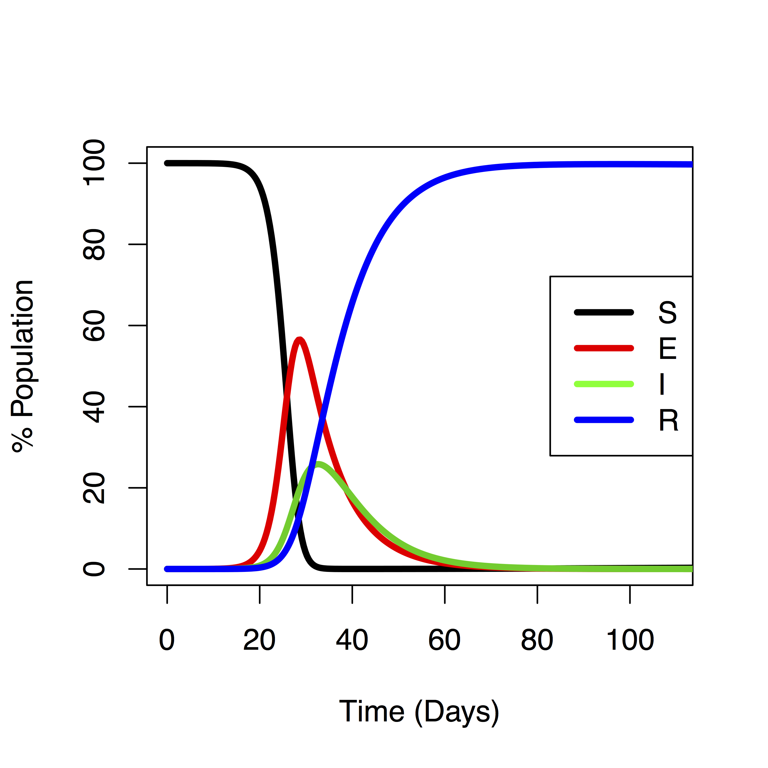
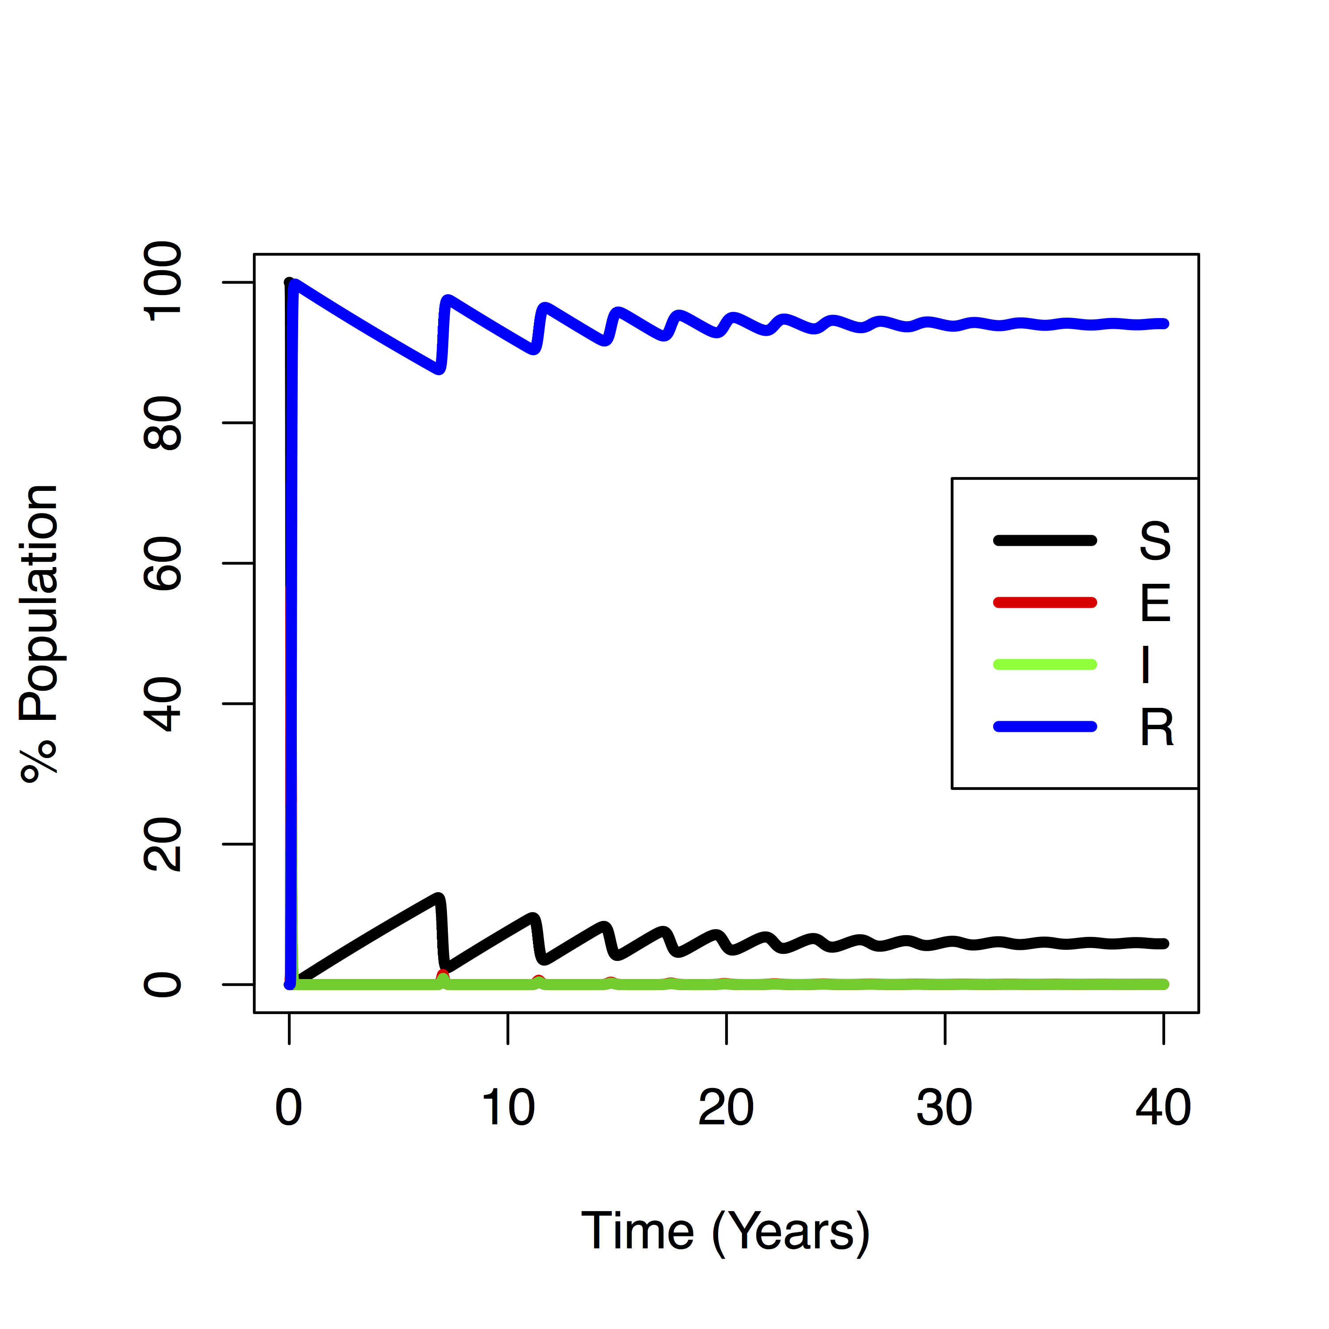
SEIR model with demography
l
SEIR model analogous to damped
Pendulum (simple harmonic oscillator)
with natural period of oscillation
Can force an oscillator to vibrate at arbitrary frequencies by varying parameters over time

Slide 9
Seasonality in transmission
For infectious disease models many (potential) model parameters have season patterns of variation
Birth rates, mortality rates, temperature, precipitation, environmental survival
Analysis of incidence data from England and Wales reveals strong evidence for seasonal variation in estimated transmission rates co-incident with the (average) timing of the school terms (red)
Becker & Grenfell https://doi.org/10.1371/journal.pone.0185528
Fine & Clarkson (1982) https://doi.org/10.1093/ije/11.1.5

Slide 10
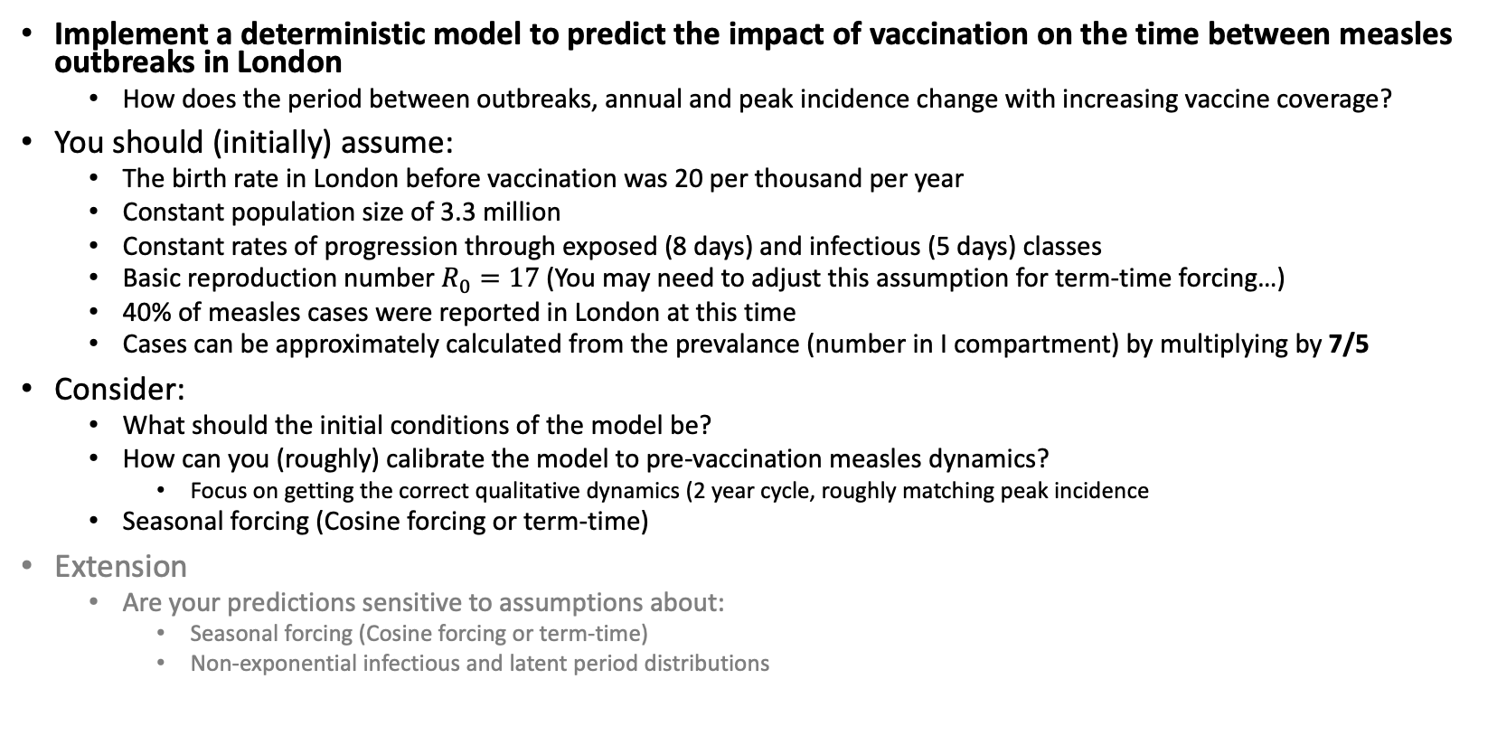
Challenge
Implement a deterministic model to predict the impact of vaccination on the time between measles outbreaks in London
How does the period between outbreaks, annual and peak incidence change with increasing vaccine coverage?
You should (initially) assume:
The birth rate in London before vaccination was 20 per thousand per year
Constant population size of 3.3 million
Constant rates of progression through exposed (8 days) and infectious (5 days) classes
Basic reproduction number $R_{0}=17$ (You may need to adjust this assumption for term-time forcing…)
40% of measles cases were reported in London at this time
Cases can be approximately calculated from the prevalance (number in I compartment) by multiplying by 7/5
Consider:
What should the initial conditions of the model be?
How can you (roughly) calibrate the model to pre-vaccination measles dynamics?
Focus on getting the correct qualitative dynamics (2 year cycle, roughly matching peak incidence
Seasonal forcing (Cosine forcing or term-time)
Extension
Are your predictions sensitive to assumptions about:
Seasonal forcing (Cosine forcing or term-time)
Non-exponential infectious and latent period distributions

Slide 11
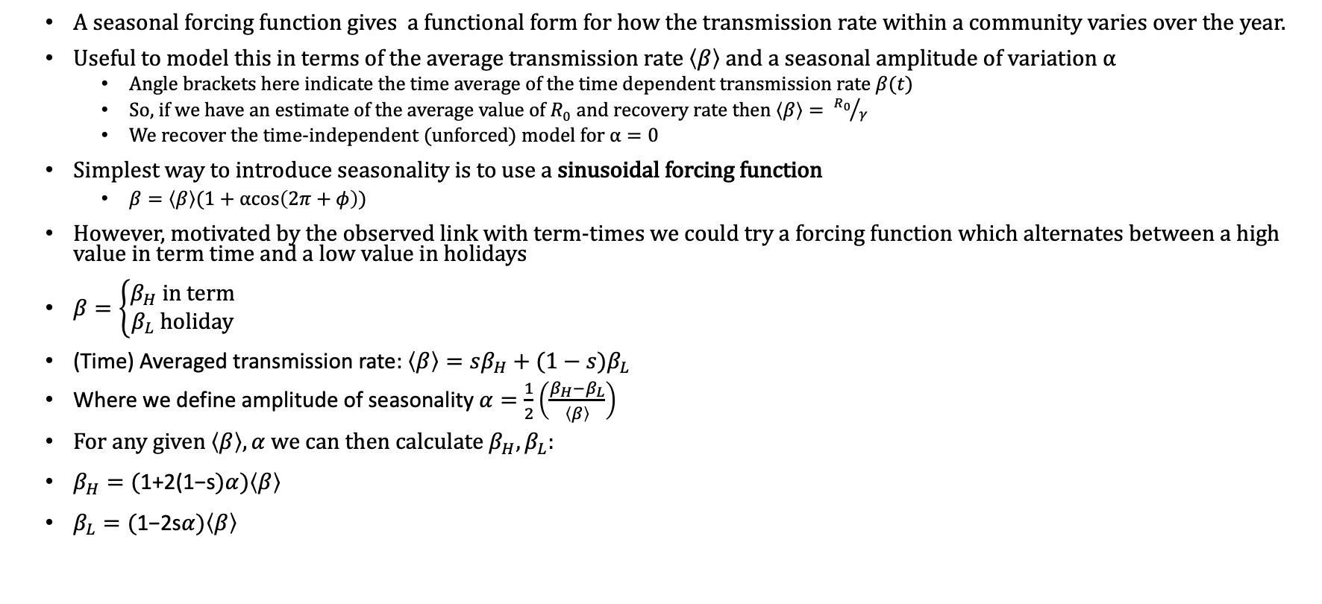
Notes on Forcing Functions
A seasonal forcing function gives a functional form for how the transmission rate within a community varies over the year.
Useful to model this in terms of the average transmission rate $\left\langle β\right\rangle$ and a seasonal amplitude of variation $α$
Angle brackets here indicate the time average of the time dependent transmission rate $β(t)$
So, if we have an estimate of the average value of $R_{0}$ and recovery rate then $\left\langle β\right\rangle = {R_{0}}/γ$
We recover the time-independent (unforced) model for $α=0$
Simplest way to introduce seasonality is to use a sinusoidal forcing function
$β=\left\langle β\right\rangle (1+αcos\left(2π+φ\right))$
However, motivated by the observed link with term-times we could try a forcing function which alternates between a high value in term time and a low value in holidays
$β=\left\{\begin{aligned}β_{H} \text{in} \text{term} \\ β_{L} \text{holiday}\end{aligned}\right.$
(Time) Averaged transmission rate: $\left\langle β\right\rangle =sβ_{H}+(1−s)β_{L}$
Where we define amplitude of seasonality $α=\frac{1}{2}\left(\frac{β_{H}−β_{L}}{\left\langle β\right\rangle }\right)$
For any given $\left\langle β\right\rangle ,α$ we can then calculate $β_{H},β_{L}$:
$β_{H}=\text{(}\text{1+2}\text{(}\text{1−}\text{s})α)\left\langle β\right\rangle$
$β_{L}=\text{(}\text{1}\text{−}\text{2}\text{s}α)\left\langle β\right\rangle$
Bauch & Earn (2003) https://doi.org/10.1098/rspb.2003.2410

